Slide 1
OC ACM Executive Committee
Format: | Online via Zoom
Zoom Link: | https://acm-org.zoom.us/j/93004927026?pwd=NWRGR0RObUJWZFk5N0NjdFdBMUxEdz09
Date: | Nov 26, 2025

Slide 2
Agenda
Review of prior meeting minutes
Officers / Volunteers
Treasurer’s Report
January Event Preparation
Future Event Planning
Committee Business

Slide 3
Meeting Attendees
Michael Fahy
Allen Takatsuka
Dan Whelan
Marc Velasco
Nilo Niccolai
Winsor Brown
Ansel Teng
Don Choi
Trae Palmer
Shirley Tseng
Cynthia Kirkeby
Farhad Mafie
Jared Miller
Dave Harnick-Shapiro
Dawn Childs
Taylor Noh
Stephen Landaas
AJ Albrecht

Slide 4
Motions
Motion | Moved By | Seconded By | Status
Approve October 2025 Executive Committee minutes

Slide 5
Officers
Position | Volunteer
Chair | Taylor Noh
Vice-Chair | Stephen Landaas
Treasurer | Michael Fahy Ph.D.
Secretary | Marc Velasco
Communications | Allen Takatsuka
Webmaster | Stephen Landaas
SIGAI-OC Liaison | Dave Harnick-Shapiro
Membership Chair | Farhad Mafie

Slide 6
Officers (cont’d)
Position | Volunteer
University Liaison | Michael Fahy Ph.D.
Programs Chair | Jared Miller
Program Speaker Coordinators | Raman Rajan, Farhad Mafie
Program Video Coordinator | Trae Palmer
Social Media Committee | Don Choi, Cynthia Kirkeby, Trae Palmer
Membership Committee | Open
Hospitality | AJ Albrecht
Fundraising Coordinator | Open
Members at Large | A. Winsor Brown, Shirley Tseng, Nilo Niccolai Ph.D., Ansel Teng, Dan Whelan

Slide 7
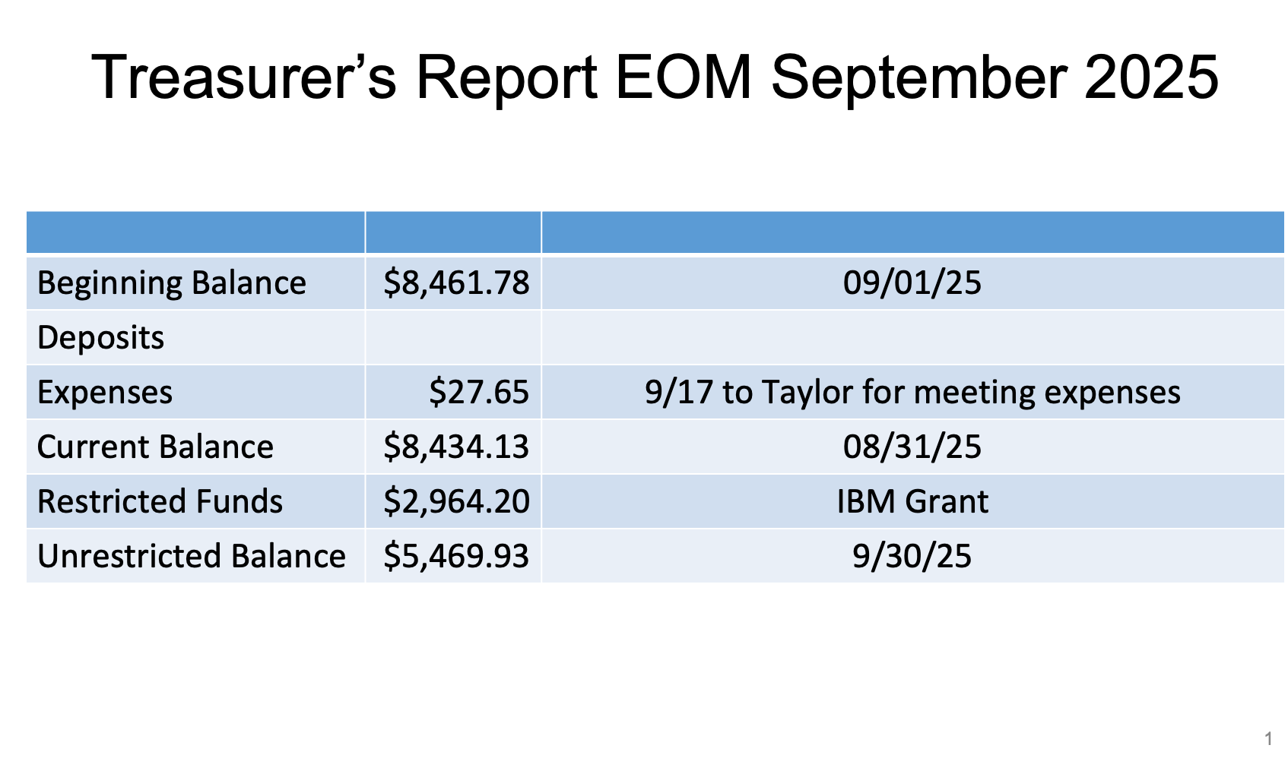

Slide 8
January Event Planning
Any follow-ups?

Slide 9
Next Program Event Planning
Date | Speaker | Talk
3/18/2026
1/21/2026
11/19/2025 | Dr. Constance Steinkuehler | Games as Social Platforms
9/17/2025 | Dr. Taylor Patti | Quantum Computing - Fundamentals, Hardware, and HPC/AI Opportunities
7/16/2025 | Distinguished Speaker Mohammad Abdullah Al Faruque | Cyber-Physical Vulnerabilities in Autonomous Systems
5/21/2025 | Prof. Chen Li & Jiadong Bai | Texera: Cloud-Based Collaborative Data Science and AI/ML Using Workflows
3/19/2025 | David Cunningham Business Technology Officer at Alvaka | Ransomware Recovery: Navigating the Storm
1/15/2025 | Peter D. Chang, M.D. UCI Applied AI Research Center | AI in Medicine: From Concept to Clinic, What it Takes to Deploy and Commercialize AI in Medicine

Slide 10
Future Program Event Candidates (UCI)
Machine Learning
Stephan Mandt (anomaly detection without supervised learning)
Roy Fox (reinforcement learning, robotics)
Jing Zhang (ML applied to bioinformatics)
Alex Berg (computational visual recognition, starts @UCI Spring 2022)
Dr. Peter Chang (AI and Medicine)
Control Theory & Robotics
Magnus Egerstedt, Dean of Engineering, Samueli School of Engineering
(Referred by Aaron Ames of Caltech)
System
Sang-Woo Jun (acceleration)
Sangeetha Jyothi (Data center networking)
Moshen Imani (bio-inspired computing)
Theory
Vijay Vazirani (involved with the design of early Google Ad Placement Alg.)
Informatics
Vladimir Minin (Data analysis wrt infectious diseases)
Stacy Branham (human-centered computing)

Slide 11
Future Program Event Candidates
Potential Speakers
Topics
Caltech Professor Yisong Yue, ML [Dan]
Andrew Kirkland, CISO at Starbucks
Beth Harnick-Shapiro [Marc]
Bill Lobig VP IBM Software Development - Analytics [Marc]
Christophe Begue, ex-IBM (Blockchain) now PDF Solutions
John Koon, Tech Idea Research - Autonomous Cars
Bill Cleveland – Data Visualization (M. Fahy has reached out to him)
Alanna Gombert, Global CRO at MetaX – Blockchain
Sushant Rao - Operational Analytic Data Stores (M. Fahy has reached out to him)
Paul Anderson, Anderson Software Group – Go language
Alyssa Columbus, Data Scientist at Pacific Life - Robust and Reproducible Predictive Modeling Workflows
Dianne Cook, Prof. of Business Analytics, Monash University – Data Visualization
Interest in potentially having a future talk focused on Privacy By Design (PbD) and related best practices identified in March meeting
Feedback from three May meeting attendees:
  LLM applications and Real-world use cases
  IOT
  AI
  Cybersecurity discussion around the current attack approaches
  IP law update

Slide 12
Committee Business
Volunteer Updates
New/Other Business
Review of November meeting

